Slide 1
BUSINESS CASE
IMPLEMENTATION OF
MICROSOFT DYNAMICS NAVISION

Slide 2
Problem Statement
Currently we have disparate systems used by various departments & business units of ISKCON Bangalore & the associated trusts, which is resulting in a) audit and control issues, b) redundant data entry, c) repeated reconciliation, d) loss of data integrity, e) data availability issues
This has potential impact on meeting the a) statutory compliances, b) timely decision making, c) stakeholder satisfaction and d) man-power requirement.
Out of 61 processes, around 19 are handled manually in TSF-Gifts. In TSF-Foods out of 55 processes, 22 are manual.

Slide 3
Current Scenario
 | ISKCON | TSF GIFT | TSF FOOD | GST
Accounts & Finance | Tally | Tally | Tally | Tally
Fixed Asset Management | Manual | Manual | Manual | Manual
Procurement Planning | NA | Destiny ERP | Manual | Manual
Purchase to Payment | Tally | Destiny ERP | PRISM Futura | Tally
Inventory & Stores | Tally | Destiny ERP | PRISM Futura | Tally
Sales Forecasting | NA | Manual | Manual | Manual
Sales Management | NA | Destiny ERP | Manual | Tally
Production Planning | Manual | Destiny ERP | Manual | NA
Quality Control | Manual | Manual | Manual | Manual
Donations Management | Dhananjaya | NA | NA | NA
Guest House | Guest House | NA | NA | NA
Other incomes (Ticket, Rental) | Manual | NA | NA | NA
Payroll Management | Pay Genie ( procured from TenXLabs)

Slide 4
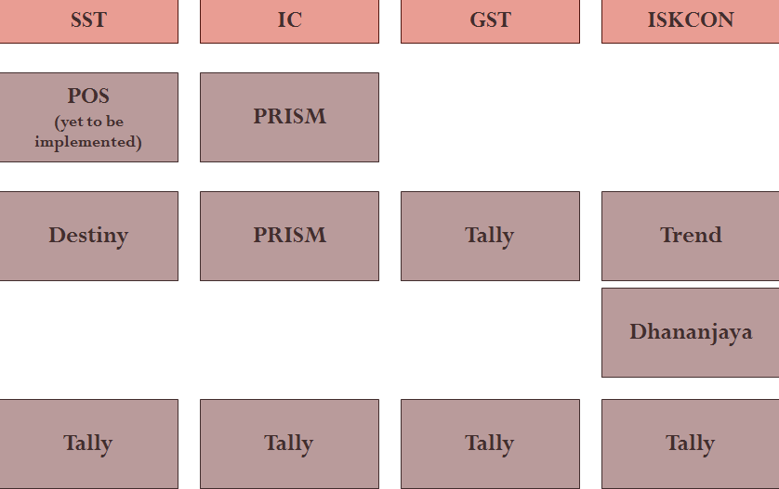
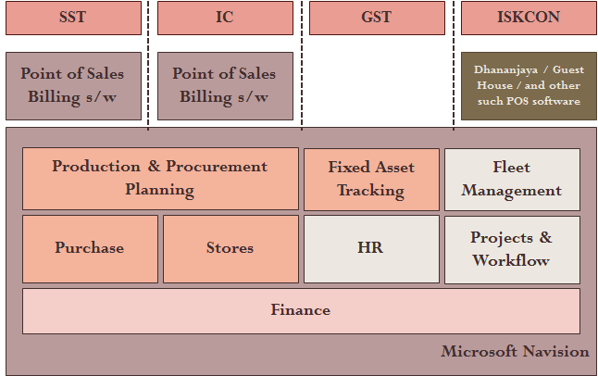
Solution
To implement an ERP which integrates all the departments and business units of ISKCON and the affiliated trusts.
Integrate Donation Management System and Point of Sales applications with ERP.
Current Island Systems
Proposed Integrated System

Slide 5
Project Objectives
ERP Implementation for ISKCON, TSF (Gifts and Foods), GST covering the following modules:
Accounts & Finance
Procurement to Payment
Inventory & Stores
Quality Control
Production Planning
Sales Forecasting & Sales Management
Fixed Assets Register
Job Management (Projects)
Dhananjaya (Donor Management System) Integration

Slide 6
Business Value - Strategic
Enables management to make quicker & better decisions by ensuring timely availability of accurate data.
Enables organization to improve customer experience by taking further specific projects.
Enables organization to scale up.
Improves opportunities for cross-selling.

Slide 7
Business Value - Customer
Enables accounts to do purpose-based accounting of the donation income received which will in turn bring in more transparency, there by improving the good-will.
We can provide report on Donation Utilization to our Donors.
We can design our donation schemes based on the purpose.

Slide 8
Business Value - Compliance
Enables accounts to implement better accounting practices according to industry standards.
Information System Audit conducted on the disparate systems have identified 81 control issues out of which ____ can be addressed and resolved by implementing an integrated software system like ERP.
Implementation of ERP will also help us in Improved Budgetary Control, Improved Warning System and Improved Regulatory Compliances.

Slide 9
Business Case - Operational
Reduction in bad debts owing to lack of internal control : In 2014-2015 we have written off Rs. 11.5 Lakhs in food division of TSF & GST and Rs. 4 Lakhs in Gift Division of which 30% is due to wrong accounting and 40% due to billing even after exceeding credit limit as per policy. Such instances (which caters to 70% of the bad debts) can be totally avoided if we have the required controls which ERP provides.
Reduction in cheque clearance time: The delays in manual cheque processing procedure at Dhananjaya & Finance department can be eliminated by integrating Dhananjaya with ERP. The cycle time can be reduced by 1 day.

Slide 10
Business Value - Operational
Elimination of Redundant Data Entry Effort: Currently accounts team spend more than 910 man days in reentering the data from various entities. This redundant effort can be completely eliminated. (see next slide)
Reduction in Reconciliation Effort: The accounts team spends more than 60 man days in an year reconciling the inter trust balances which can be avoided by implementation of ERP.

Slide 11
Redundant Data Entry Effort
Type of Transaction | Transactions / Year | Approximate Effort
Donation Receipts | 14400 | 1200 hrs
Bank Clearance Updates | 27240 | 150 hrs
Bank Challan for Cheque Deposits |  | 450 hrs
Donation data Reconciliation | 14400 | 24 hrs
Purchase data from TSF Food | 4836 | 1370 hrs
Sales data from TSF Food | 5360 | 524 hrs
Purchase data from TSF Gifts | 2668 | 755 hrs
Sales data from TSF Gifts | 2606 | 521 hrs
Purchase data from GST | 487 | 138 hrs
Sales data from GST | 40 | 2 hrs
Purchase data from ISKCON | 5058 | 1433 hrs
Purchase data from Krishnamrita | 1680 | 476 hrs

Slide 12
Data Collection Effort – TSF Gifts
Currently the team handling TSF Gifts spends lot of time collating and processing the data using Excel with lot of manual intervention, which can be considerably reduced by having an integrated system. The post automation effort is 20% of current effort.
Process Name | Current Effort | After Automation
Sales Forecast & Planning | 3 days | 1 day
Purchase Planning | 10 days | 1 day
Purchase Order Processing | 8 days | 3 days
Purchase Inward Notes | 15 days | -
Goods Receipts / QC Inspection | 12 days | 3 days
Indent Processing | 15 days | 4 days
Total Effort in man days per month | 63 days | 12 days

Slide 13
Reduction in Processing Effort – TSF
Currently the team handling TSF Food division spends lot of time processing the data, which can be considerably reduced by having an integrated system which minimizes the data entry / consolidation / reconciliation effort. The post automation effort is 30% of the current effort being spent.
Process Name | Effort / Month | Post Automation
Production Planning | 3 days | 1 day
Purchase Planning & Procurements | 15 days | 5 days
Stores | 12 days | 4 days
Sales | 4 days | 2 days
Debit Notes | 5 days | No effort
Total Effort in man days Per Month | 39 days | 12 days

Slide 14
Additional Resource Requirements
With the current growth plan TSF need to add resources for data entry and collating the data. These extra man power can be avoided by implementing ERP.

Slide 15
Summary – 5 year Cost Saving
Cost Saving due to elimination of redundant data entry at Finance: 970 man days x Rs. 800 x 5 years = 38,80,000
Cost Saving due to process improvement and automation in TSF Gifts Division: 67,70,000
Cost Saving due to process improvement and automation in TSF Foods Division:

Slide 16
Total Cost of Ownership - ABS
 | Year 1 | Year 2 | Year 3 | Total
ERP License Cost | 52,00,000 | 12,00,000 |  | 64,00,000
Implementation Cost - vendor | 35,00,000 | 35,00,000 | 10,00,000 | 80,00,000
Implementation Cost – internal | 17,50,000 | 17,50,000 | 5,00,000 | 40,00,000
Microsoft Support (BREP) | 10,00,000 | 12,00,000 | 12,00,000 | 34,00,000
Partner Support Cost | 4,00,000 | 8,00,000 | 8,00,000 | 20,00,000
Product Upgrade / Migration |  |  | 20,00,000 | 20,00,000
ERP Manager / Team | 8,00,000 | 8,80,000 | 9,60,000 | 26,40,000
Server Hardware | 10,00,000 |  | 3,00,000 | 13,00,000
Total Cost |  |  |  | 2,97,40,000

Slide 17
Total Cost of Ownership

